Slide 1


Solar Energy for a Decarbonised Future -
Knowledge Transfer for Environmental Education and Awareness (SolAware)
Summer training 2024 First week
Dr. Ahmed Suhail

Slide 2

Activities and outcome of this training
A1- Develop a curriculum for solar training.
A2- Develop the educational materials and hands-on lab activities.
A3- Identify participating students.
A4- Develop a virtual learning process for the manufacturing of solar cells. This includes complete sessions for each step of the fabrication process.
A5- Set up a large solar system and measure its characteristics.
Outcomes:
O1- A culture of sustainability from an early age and solar technology integration into academic programs.
Provide solar training to students at Mosul University.

Slide 3
The first week of Summer training
Session 1 (Introduction to solar technology, clean process and Lithography in the clean room) on the 1st of July at 10:00 am via Microsoft Team.
Session 2 (Sputtering and Wet transfer process) on the 3rd of July at 10:00 am via Microsoft Team.

Slide 4
Session 1

Slide 5
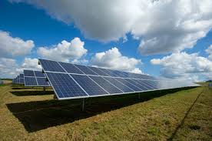
Introduction
What is a solar cell?
It is an electronic device that converts the sunlight into electricity by the photovoltaic effect.

Slide 6
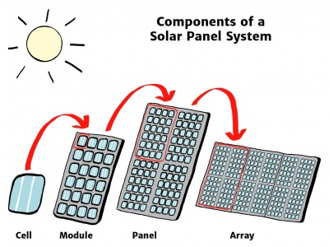
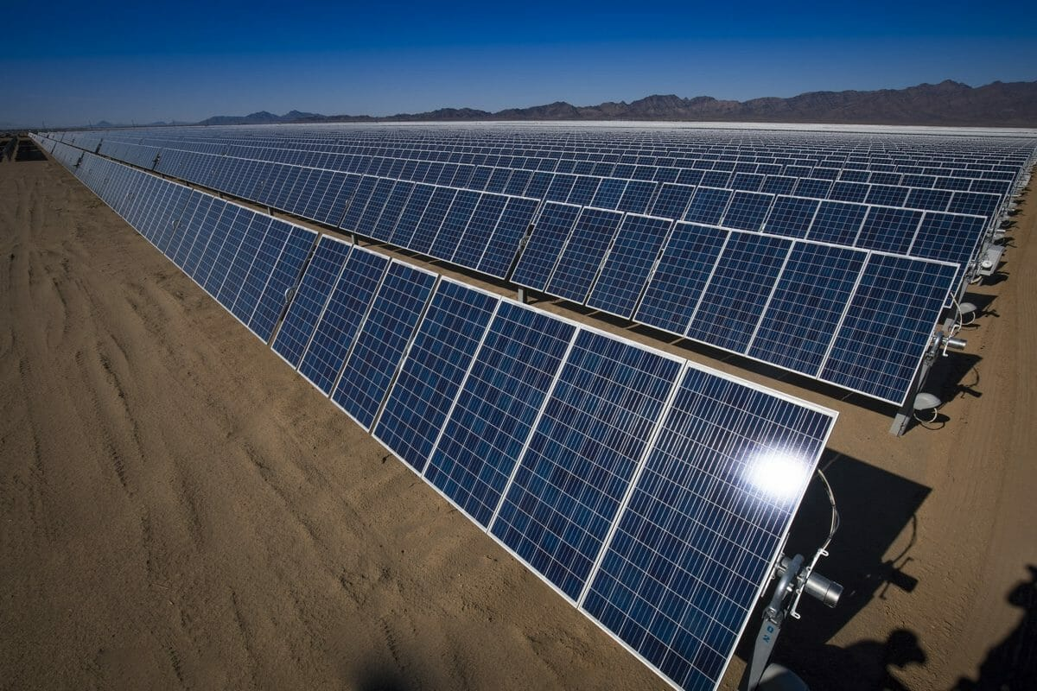
What is solar farm?
Solar farm

Slide 7
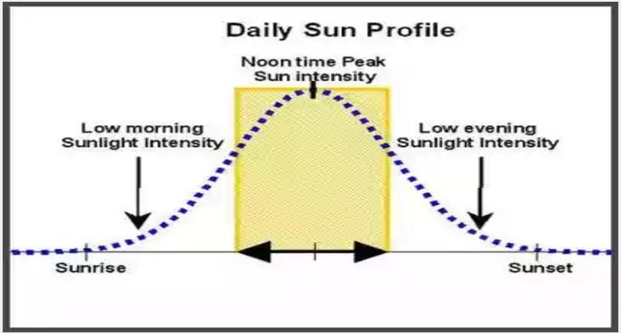
Effect of Intensity on power produced by solar cells

Slide 8
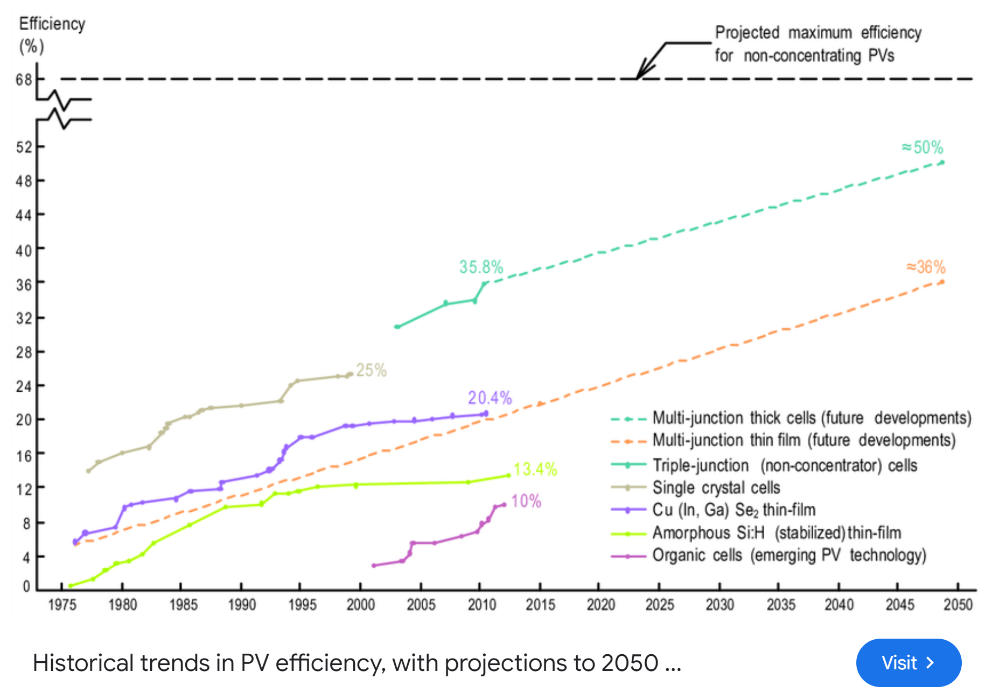

Slide 9
How many ways can be solar cells prepared?
P-N junction solar cells.
Schottky junction solar cells.
p-n junction solar cell.
Schottky junction solar cell.

Slide 10
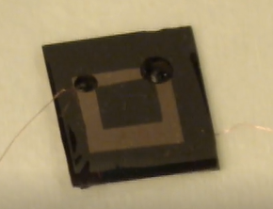
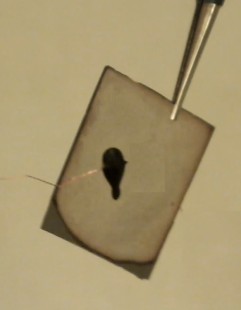
What we are going to fabricate in the summer training?
Back side of a graphene/n-Si Schottky junction Solar cell
Front side of a graphene/n-Si Schottky junction Solar cell

Slide 11
Which steps do we need to fabricate graphene/Si solar cells?
Figure. Fabrication process of a graphene/n-Si Schottky junction constructed via a top-window structure. (a) Cleaning process of Si wafers. (b), (c) and (d) forming contacts through lithography and sputtering processes. (e) Transferring CVD- graphene.

Slide 12
(Cleaning process)

Slide 13
Outlines
Introduction
Methodology

Slide 14
Methodology
Materials:
N type-silicon wafers.
Cutter.
Ruler.
Acetone.
Isopropanol.
DI-water.
Potassium Hydroxide Oxide (KOH).
Clean room tissue.
N₂ gas.
Si wafer

Slide 15


How can we cut Si wafers?
Cutting
Right way

Slide 16
How can we cut Si wafers?
Cutting
Destroying your wafer
Wrong way

Slide 17

How can we clean Si wafers?
After cutting Si wafer into 1 Cm² areas, cleaning process will start as follow:
Removing organic/inorganic residue:
Immersing Si sample in Acetone for 8 minutes.
Immersing Si sample in Isopropanol (IPA) for 6 minutes.
Immersing Si sample in DI-water for 2 minutes.
Removing native oxide:
Immersing Si sample in 40% KOH for 1 minute.
Immersing Si sample in DI-water for 2 minutes.
Before Cleaning
After Cleaning

Slide 18
What is the next step of fabrication process?
Creating a square of metal on the front of Si samples through lithography and sputtering processes

Slide 19
(Photolithography process)
Dr. Ahmed Suhail

Slide 20
Outlines
Introduction
Methodology

Slide 21
Introduction
What is Photolithography? What is the important of it?
It is a process to create a pattern onto a specific area of substrates. By using this process, you can pattern micro parts (or larger parts) of metals, semiconductors and insulators, which will be coated after. So, This process is crucial in the electronic industry.
Front side of device, showing a pattern of Au onto Si substrate.

Slide 22
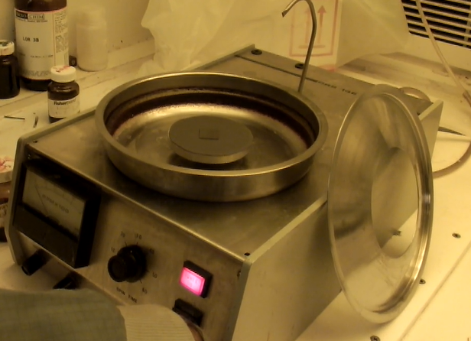
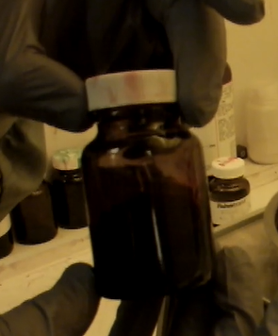

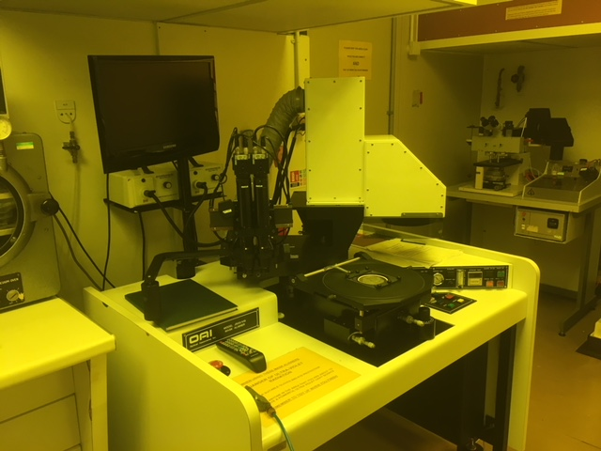
Methodology:
Materials:
Positive-photoresist.
Pipettes.
Hot plat.
Spin coater (machine).
Mask.
Mask aligner (machine).
Developer.
DI-water.
Clean room tissue.
N₂ gas.
Photoresist
Pipette
Spin-coater
Mask aligner

Slide 23
Photolithography process:
a-Coating with photoresist
b- Mask+ Exposing to UV
c- Developing
d and e- Coating procedure
f- Lift off process

Slide 24
Session 2

Slide 25
(Sputtering process)
Dr. Ahmed Suhail

Slide 26
Outlines
Introduction
Methodology

Slide 27
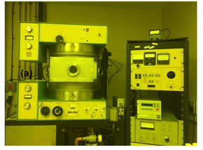
Introduction
What is sputtering technique? What is the important of it?
A sputtering technique is used to deposit the required materials (metals, semiconductors and insulators) on desired substrates. It is important to achieve low-cost coating.
Three targets 8’’ sputtering machine

Slide 28
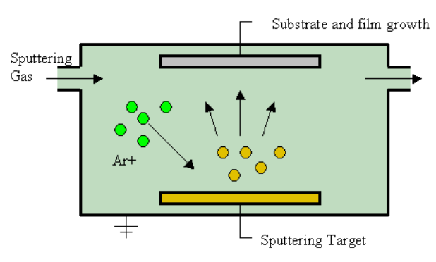
What is the key in sputtering process?
The key is the discharging of a carrier gas (such as, Argon).

Slide 29
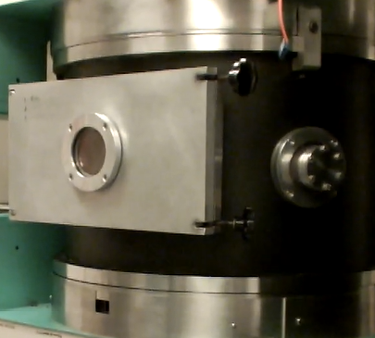
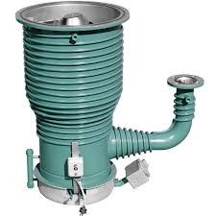
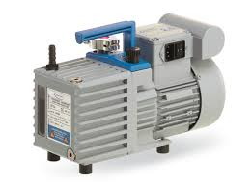
Sputtering machine includes:
1- Chamber
2- Mechanical pump
3- Diffusion pump
Chamber
Mech. Pump
Diffusion Pump

Slide 30
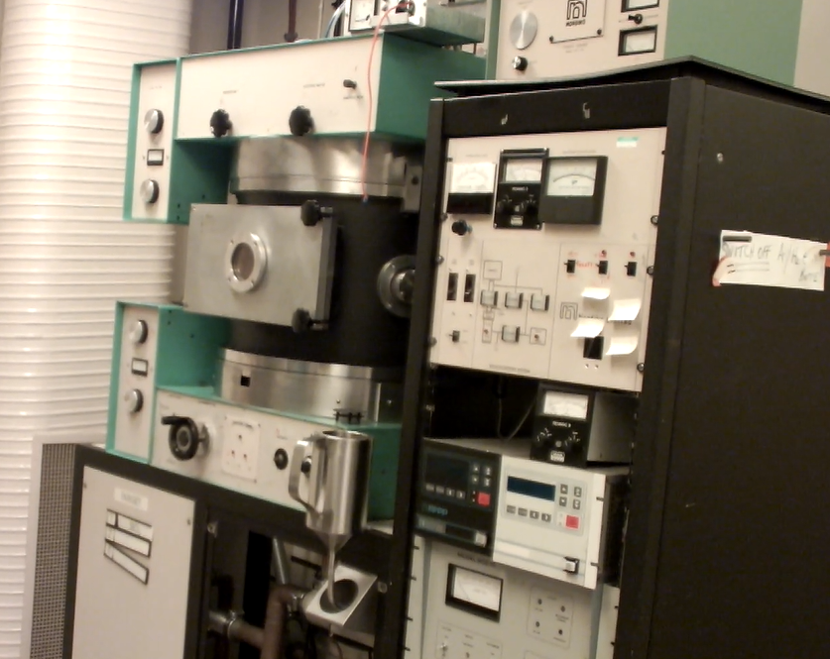
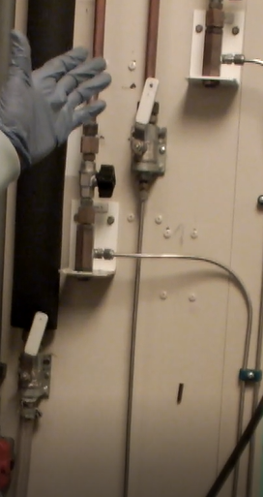
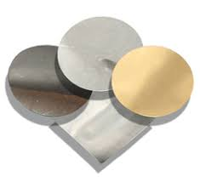
Methodology:
Materials and system:
Water
N₂
Argon (Ar)
Compressed air
Sputtering machine
SiO₂, Au, Ag and Cr targets.
5
1,2,3 and 4
6

Slide 31


Sputtering process
Air molecules
Substrate
Target
Pumping down to 10⁻³ Torr using mechanical pump
Pumping down to 10⁻⁶ Torr using diffusion pump
Ar
Ar
Ar⁺
Discharging process
Gas in

Slide 32
What are the next steps of fabrication process?
After coating samples, lift-off process will be applied.
Coating with SiO2/Cr/Au
Lift-off process

Slide 33
(Wet transfer process of CVD-graphene)
Dr. Ahmed Suhail

Slide 34
Outlines
Introduction
Methodology

Slide 35
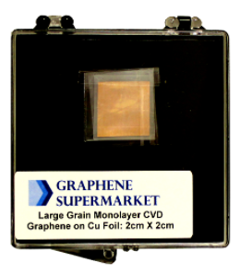
Introduction
Chemical Vapour Deposition (CVD)- graphene
Chemical vapour deposition is the best way to obtain high quality and large area of graphene.
CVD-graphene on copper foil

Slide 36
How is CVD-graphene formed on Cu in the fabrication process used?
The wet transfer process is used to transfer graphene from Cu into desired substrates.

Slide 37
Methodology:
Materials and system:
Spin coater
PMMA solution
Pipettes.
Hot plate
Nitric acid solution
Water
Ammonium persulfate solution
Acetone
IPA

Slide 38
Back side of a graphene/n-Si Schottky junction Solar cell
Front side of a graphene/n-Si Schottky junction Solar cell

Slide 39
Wet transfer process

Slide 40
Which steps do we need to fabricate graphene/Si solar cells?
Figure. Fabrication process of a graphene/n-Si Schottky junction constructed via a top-window structure. (a) Cleaning process of Si wafers. (b), (c) and (d) forming contacts through lithography and sputtering processes. (e) Transferring CVD- graphene.

Slide 41

Conclusions:
1- Introduced 2 sessions on the manufacturing of graphene/Si Schottky junction solar cells.
2- Support Sustainable Development Goals (SDG) such as Quality Education (SDG 4) and Affordable and Clean Energy (SDG 7).

